Slide 1
Reconstruction of a polymer connectivity using the HiC experiments
Ofir shukron

Slide 2
Background

Slide 3
Theory- from encounter signals to structure

Slide 4
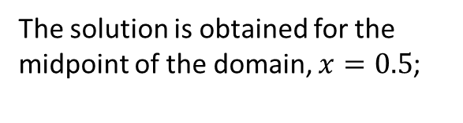

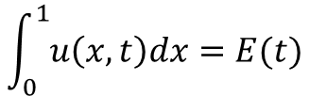
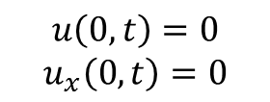


Smoothing by solving the inverse heat equation
The solution is obtained for the midpoint of the domain, $x=0.5$;
We set: $f\left(x,t\right)=\left\{\begin{aligned}1, x=0 \\ 0, else \end{aligned}\right.$
$$α=−1$$
Boundary conditions: $u\left(0,t\right)=u\left(1,t\right), u_{x}\left(0,t\right)+αu\left(0,t\right)=0$
Temp.
1
$$u\left(1,t\right)=0$$
space
0.5
The experimental data u(0.5,t) is inserted such that
$$u\left(0,t\right)=0$$
$$u_{x}\left(0,t\right)=0$$
0
$$\int_{0}^{1}{u\left(x,t\right)dx}=E(t)$$
Time
$$u(x,0)$$
temperature
0
0
0.5
1

Slide 5
Reconstruction

Slide 6
Comparison of smoothing techniques

